Slide 1
Equality in an equation
Solving linear equations

Slide 2
how to use Oak lessons

Slide 3
I can appreciate that in an equation the two sides of the equals sign balance.

Slide 4
An equation is used to show two expressions that are equal to each other.

Slide 5

Equality in an equation
Using bar models to rearrange equations
Using balances to represent equations

Slide 6
Using bar models to rearrange equations
When we write equations we can rearrange these to find other equations which are true for that relationship.
For example, if we know that 8 + 2 = 10 we also know that:
2 + 8 = 10
10 − 8 = 2
10 − 2 = 8
Lucas has written the equation 28 + 49 = 77
What other equations can he write from this information?
77 − 49 = 28 77 − 28 = 49 49 + 28 = 77

Slide 7
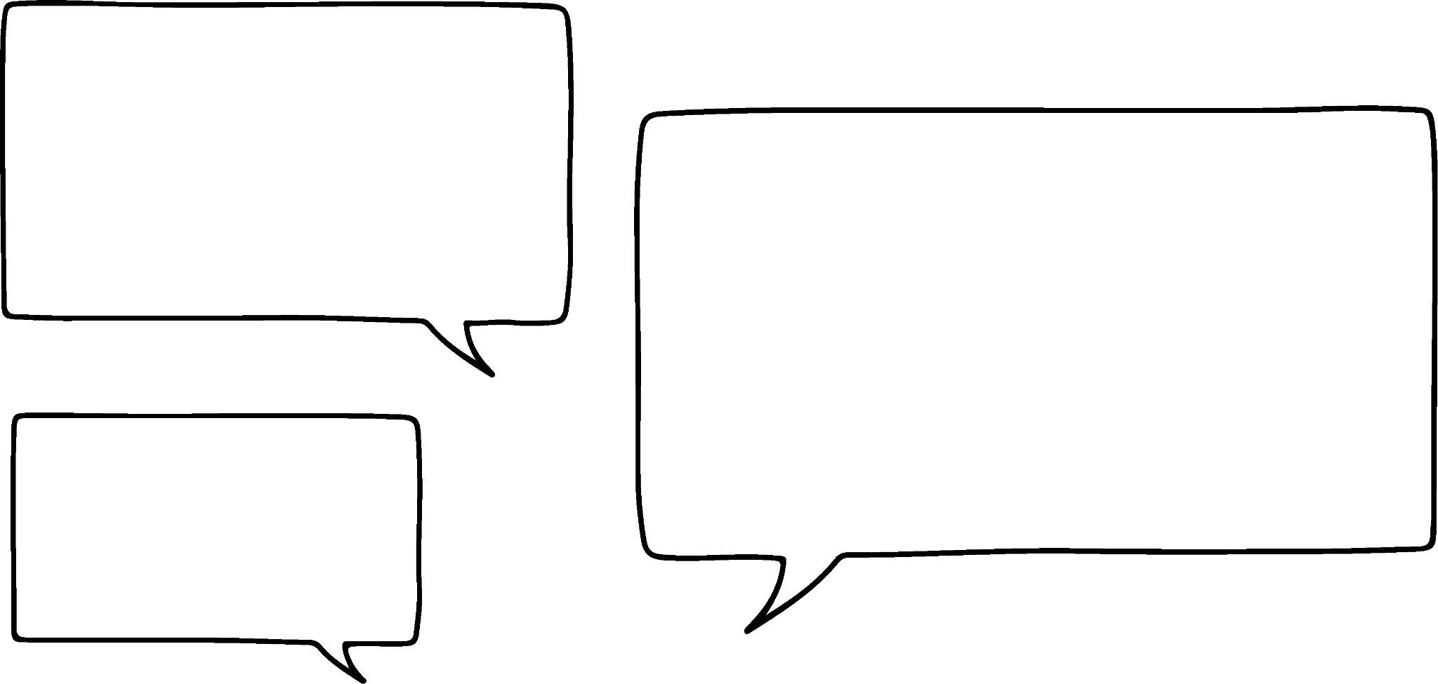

Using bar models to rearrange equations
I can also show this with a bar model
28
49
77
49 + 28 = 77
77 − 28 = 49
Lucas
77 − 49 = 28
77 − 49 − 28 = 0
Because 28 + 49 is equal to 77 the bars must be the same length.
How could Lucas change his bar model to show that 28 + 49 + 13 = 90?

Slide 8
Using bar models to rearrange equations
I can also show this with a bar model
28
49
13
90
77
13
49 + 28 = 77
77 − 28 = 49
Lucas
77 − 49 = 28
77 − 49 − 28 = 0
How could Lucas change his bar model to show that 28 + 49 + 13 = 90?

Slide 9

Using bar models to rearrange equations
The same thing is true for bar models with variable terms.
a
c
50
This is a bar model for the equation a + c = 50
I’ve written a different equation from this bar model.
Lucas
Laura
What could Laura have written?
c + a = 50
50 − a = c
50 − c = a
50 − c − a = 0
We do not know the value of a and c so we do not know which bar should be bigger. Be aware that bar models are just a representation.

Slide 10
Using bar models to rearrange equations
If I have the equation
x − y = 5 what other equations are also true?
How could we draw a bar model to show an equation with a subtraction?
x
Laura
5
y
In this case x has to be larger than 5
What other equations are true?
y + 5 = x
x − 5 = y
5 + y = x
x − 5 − y = 0
Is Laura correct?
No, x could be 3 and y could be −2 then 3 − (−2) = 5

Slide 11
Using bar models to rearrange equations
Bar models are just a representation of an expression or equation.
They are great for showing the relationship between terms in an equation and making sense of rearranging equations into different forms.
We cannot always use the size of the bars to give us information about unknowns or variables, particularly involving negative values.

Slide 12

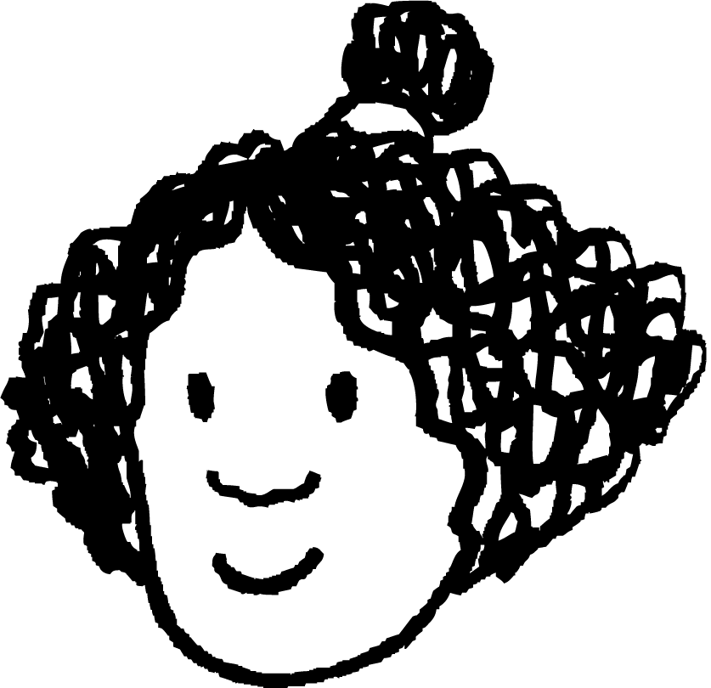


Using bar models to rearrange equations
How could we draw a bar model for the equation 4x + 5 = 2x + 9 ?
x
x
x
x
5
x
x
9
Which of these equations are also correct?
9 + 2x − 4x = 5
4x + 5 − 2x = 9
2x + 9 − 5 = 4x
4x + 5 −9 − 2x = 0
Sam
Sofia
Alex
Izzy
All of them

Slide 13

Using bar models to rearrange equations
If y − x = 17 which of the following are also true?
You could draw a bar model to help.
y
17
x
y − 17 = x
x − 17 = y
17 − x = y

Slide 14
Using bar models to rearrange equations
Match the equations to the bar models. Each bar model can match with multiple equations.
A
B
C
x
x
x
27
x
x
x
x
x
27
42
42
27
x
42
D
3x − 42 = 27
E
3x = 42 + 27
F
x = 42 − 27 − 2x
G
27 = x + 42 − 2x
H
2x + 27 − x = 42
I
42 − 3x = 27
J
27 + 3x = 42
K
2x + x = 42 + 27
2) For each bar model write another equation which is also true.

Slide 15
Using bar models to rearrange equations
Match the equations to the bar models. Each bar model can match with multiple equations.
A
B
C
x
x
x
27
x
x
x
x
x
27
42
42
27
x
42
F
x = 42 − 27 − 2x
E
3x = 42 + 27
G
27 = x + 42 − 2x
I
42 − 3x = 27
D
3x − 42 = 27
H
2x + 27 − x = 42
J
27 + 3x = 42
K
2x + x = 42 + 27

Slide 16
Using bar models to rearrange equations
2) For each bar model write another equation which is also true.
x
x
x
27
x
x
x
x
x
27
42
42
27
x
42
E.g. 3x + 27 = 42
E.g. 3x − 27 = 42
E.g. 2x + 27 = x + 42
42 − 27 = 3x
3x − 27 − 42 = 0
2x + 27 − 42 = x
42 − 27 − 3x = 0
2x = x + 42 − 27
2x + 27 − x − 42 = 0
There are many other possible answers.

Slide 17
Equality in an equation
Using bar models to rearrange equations
Using balances to represent equations

Slide 18
Using balances to represent equations
We can start to make sense of manipulating equations using a balance model.
This is a balance scale.
They can be used in real life to measure the mass of objects, often ingredients for cooking or baking or to compare the mass of objects.
They have two ‘scale pans’, one either side which objects can be placed on.

Slide 19
Using balances to represent equations
The scale pans are at the same height because the scale is balanced.
5
When there is nothing on either scale pan then the scale is balanced.
What do you think will happen when I put a mass of 5 g on the left hand side (LHS)?
5
The left hand side is now heavier so the scales are no longer balanced.

Slide 20
Using balances to represent equations
What do you think will happen if I put a mass of 5 g on the right hand side (RHS)?
5
5
5
The scales will balance again.
When the left and right hand sides have the same mass, the scales will be balanced.

Slide 21


Using balances to represent equations
What can you tell me about the mass of the orange (LHS) and the lemons (RHS) ?
The orange has the same mass as the 2 lemons.
What will happen if I add a lemon to the LHS?
The scales will no longer be balanced. The LHS will be lower.

Slide 22
Using balances to represent equations
What will happen if I add a mass of 7 g to each side?
7
7
The scales will remain balanced.

Slide 23
Using balances to represent equations
What can you tell me about the mass of the orange and lemon now?
200
50
5
Their combined mass is 255 g.

Slide 24
Using balances to represent equations
We can use balance scales to manipulate equations and maintain equality.
As with any representation, there are limitations.
For this lesson we will assume the x tile has a positive mass.
Once we are confident balancing equations we will no longer need the representation.
x
x
1
x
x
1
x
1
1

Slide 25
Using balances to represent equations
This balance scale represents the equation 3x + 1 = 2x + 3
What will happen if I take an x tile off the left hand side?
x
x
1
x
x
1
x
x
1
x
1
1
The scales will not be balanced.
x
1
What could I do to balance the scales again?
x
1
1
Take an x tile off the right hand side as well

Slide 26
Using balances to represent equations
Adding the same value to both sides of the scales will keep them balanced.
x
1
1
1
1
x
1
1
1
1
1
1
Just like adding the same value to both bars in a bar model maintains the equality of the bars.
5
2
x
x
1
2
2x + 1 | = | 5
2x + 1 + 2 | = | 5 + 2
2x + 3 | = | 7
2x + 1 | = | 5
2x + 1 + 2 | = | 5 + 2
2x + 1 | = | 5
Adding the same value to both sides of an equation maintains equality.

Slide 27
Using balances to represent equations
Here is another equation represented with scales.
x
x
1
1
1
Multiplying both sides by the same value will keep the scales balanced.
x
1
1
1
1
1
1
Multiplying both bars in a bar model by the same value keeps the bars the same length.
2
2
2
x
1
x
1
x
1
Multiplying both sides of an equation by the same value maintains equality.
x + 1 | = | 2
3(x + 1) | = | 3(2)
3x + 3 | = | 6
x + 1 | = | 2
3(x + 1) | = | 3(2)
x + 1 | = | 2
The whole expression on each side needs to be × 3
We could expand the bracket if desired.

Slide 28

Using balances to represent equations
Complete each balance scale so the left and right hand sides are balanced.
1
1
1
1
a
1
1
1
x
1
x
1
x
x
x
1
1
x
x
x
1
1
x
1
1
b
x
x
x
80
x
20
80
x
20
20
x
20
20
x
c
x
x
x
x
x
x
50
x
200
x
x
100
x
?
x
50
x
200

Slide 29
Using balances to represent equations
Complete each balance scale so the left and right hand sides are balanced.
× 2
1
1
1
1
a
1
1
1
x
1
x
x
x
1
x
x
x
1
1
x
x
x
1
1
x
x
x
1
1
or
+ (x + 3)
1
1
1
1
1
1
a
1
1
1
x
1
x
1
x
1
x
x
x
1
1
x
x
x
1
1
x
x
x
1
1

Slide 30
Using balances to represent equations
Complete each balance scale so the left and right hand sides are balanced.
+ 20
b
x
x
x
80
x
20
80
x
20
20
80
20
x
20
20
÷ 2
x
c
x
x
x
x
x
x
50
x
200
x
x
100
x
100
x
50
x
200

Slide 31
Using balances to represent equations
Choose one expression from the box to place on each scale pan.
a)
b)
c)
8 + 10 + 13
a + 6
a + b
2a
6 × 5
8 + 10 + 12
3 × 5 × 2
a
Explain your reasoning.

Slide 32
Using balances to represent equations
2)
These scales are balanced. What might the mass of the triangle and circle be? Is there more than one answer?
a)
b)
c)
7
The scales are still balanced. What might the mass of the triangle and circle be? Is there more than one answer now?
10
The scales are no longer balanced. What could be done to balance them? Is there more than one answer?
20

Slide 33
Using balances to represent equations
1a) Choose one expression from the box to place on each scale pan.
Many possible answers.
8 + 10 + 13
E.g. both expressions are the same as 6 × 5 = 30
a + b
a + 6
6 × 5
3 × 5 × 2
6 × 5
2a
8 + 10 + 12
a
6 × 5
E.g. This would balance if a = 30
3 × 5 × 2
a
E.g. This would balance if b = 6
a + 6
a + b

Slide 34
Using balances to represent equations
1b) Choose one expression from the box to place on each scale pan.
Many possible answers.
E.g. The right hand side is one bigger.
8 + 10 + 13
a + 6
a + b
8 + 10 + 12
8 + 10 + 13
6 × 5
2a
8 + 10 + 12
a
If a is positive then 2a will be larger than a
3 × 5 × 2
2a
a
a
True for any value of a
a + 6

Slide 35
Using balances to represent equations
1c) Choose one expression from the box to place on each scale pan.
Many possible answers – same as b)
8 + 10 + 13
E.g. 8 + 10 + 13 =31 and 6 × 5 = 30
a + b
6 × 5
a + 6
8 + 10 + 13
6 × 5
2a
8 + 10 + 12
a
3 × 5 × 2
a + b
True when b is positive
a
a + b
a + 6
True when b is less than 6

Slide 36
Using balances to represent equations
2)
These scales are balanced. What might the mass of the triangle and circle be? Is there more than one answer?
a)
7
There are 6 integer possibilities. e.g.
(Infinite non-integer answers)
1
6
2
5
3
4
4
3
5
2
6
1

Slide 37
Using balances to represent equations
2)
The scales are still balanced. What might the mass of the triangle and circle be?
Is there more than one answer now?
a)
7
3
4
b)
No, when the triangle was added, a mass of 3 was added. So the extra triangle is worth 3
10

Slide 38
Using balances to represent equations
2)
c)
The scales are no longer balanced. What could be done to balance them and is there more than one answer?
Yes, you could add 10 to left hand side or double the left hand side.
20

Slide 39
Equality in an equation
Bar models can be used to rearrange equations with an additive relationship.
Equations can be represented with balances. If the expressions on both sides are equal the scales will be balanced.
In order to keep a scale balanced, the same operation must be done to the expressions on both scale pans.

Slide 40

© Oak National Academy 2023.
Produced in partnership with Mathematics in Education and Industry.
Licensed on the Open Government Licence v3.0, except where otherwise stated. See Oak terms and conditions.

